Slide 1
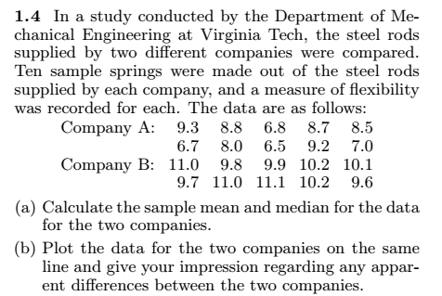
Chap 3-<number>

Slide 2
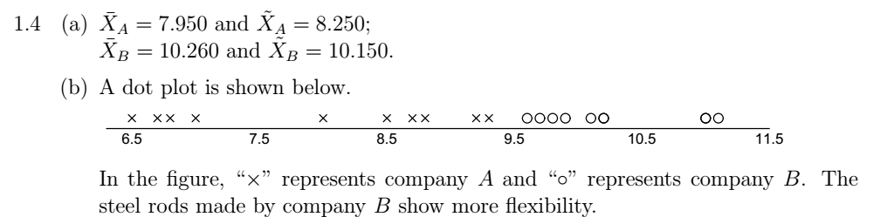

Chap 3-<number>

Slide 3
Assignment No 1(a)
Page 13: (1.1------1.6)
Chap 3-<number>

Slide 4
Shape of a Distribution
Describes how data are distributed
Measures of shape
  Symmetric or skewed
Left-Skewed
Symmetric
Right-Skewed
Mean < Median
Mean = Median
Median < Mean
Chap 3-<number>

Slide 5
Measure of dispersion/variability
Measures of variability describe the spread or the dispersion of a set of data.
Common Measures of Variability
  Range
  Variance and Standard Deviation
  Coefficient of Variation
Chap 3-<number>
Notes:
22

Slide 6





Variability
No Variability in Cash Flow
Mean
Mean
Variability in Cash Flow
Mean
Mean
Chap 3-<number>
Notes:
20

Slide 7
Dispersion
Data set I
60 62 64 64 70 mean=64 med=64 mode=64
Data set II
55 57 64 64 80 mean=64 med=64 mode=64
Chap 3-<number>

Slide 8
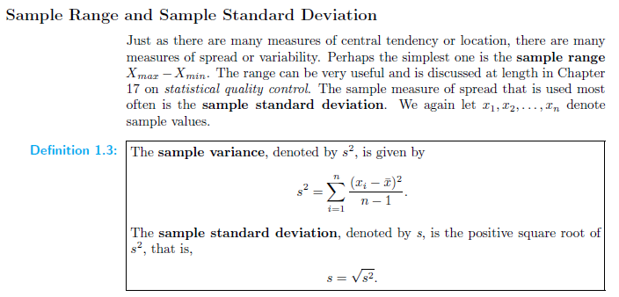
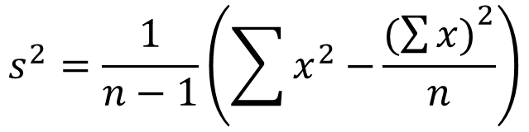
Alternate method
Chap 3-<number>

Slide 9
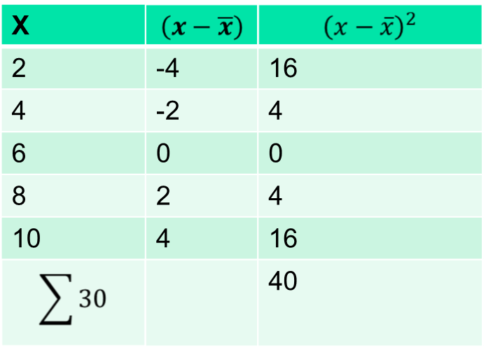
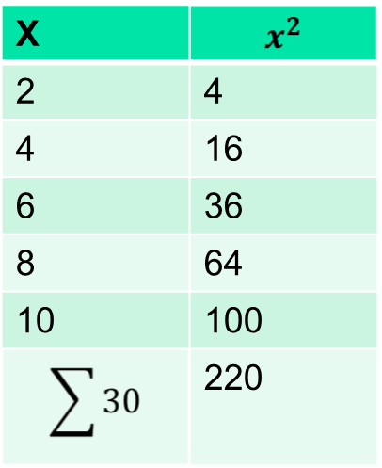
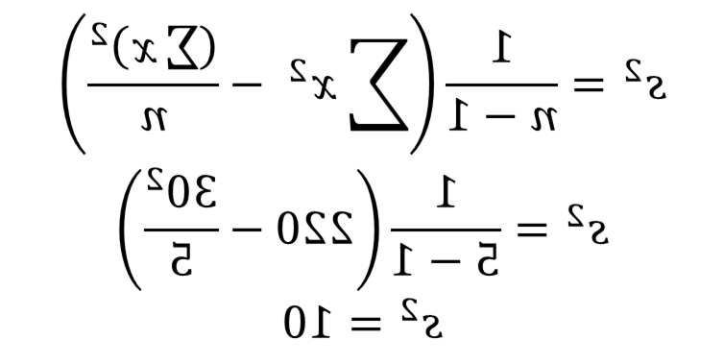
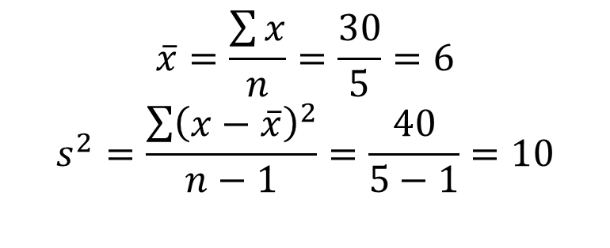
Example: 2,4,6,8,10
Chap 3-<number>

